Slide 1
A short primer on lgbt equality: How we Got Here From There
Ron Buckmire
National Science Foundation rbuckmir@nsf.gov
June 27, 2013

Slide 2
Outline
Goals of this talk
My Biography & LGBT History (Highlights from 1968-2013)
What Happened Yesterday
Questions and Discussion
Notes:
The Arc of the Moral Universe is Long, But It bends Towards Justice.

Slide 3
Goals of this talk
To provide basic information about the history of LGBT rights in the USA
To traverse my biography as a way of contextualizing and exemplifying LGBT progress
Notes:
From my perspective as someone interested in lgbt legal rights

Slide 4
THEN (IN 1968)
Most states had criminal sanctions against sodomy
No state had laws prohibiting anti-gay discrimination
No state had laws recognizing same-sex relationships
Near universal cultural taboo against homosexuality
Almost no “public homosexuals”

Slide 5
Where are we now?
June declared LGBT Pride Month
LGBT & Allies Group @NSF
Many Openly LGBT celebrities
Marriage equality before United States Supreme Court (2 cases!)

Slide 6
How did we get here from there?
VERY SLOWLY!

Slide 7
Biography: WHERE ARE YOU FROM?
Born
Grenville, Grenada (May 21, 1968)
Lived
Massachusetts, Illinois and California (1970-1978)
Christ Church, Barbados (1978-1986)
Troy, NY (1986-1994)
Los Angeles, CA (1994-2011)
Arlington, VA (2011-2013)

Slide 8
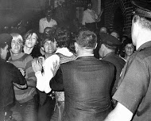
1969: The reason for the season
June 27-29, 1969: Some (mostly transgender) patrons at a gay bar called the Stonewall Inn in New York City resisted arrest during a police raid. The Stonewall Riots are thought to represent the “birth” of the modern gay rights movement.
Notes:
During a typical police raid at a gay bar called the Stonewall Inn in the East Village, a number of LGBT patrons (led by primarily gender-variant or transgender individuals ) decided to resist arrest, and three days of riots ensued. Inflexion point in a curve is the point in where there is change in the rate of decrease or the rate of increase in a variable, i.e. the second derivative is zero. Just talked about my birth and Stonewall is considered the birth of what we call the gay rights movement. There were key events before and after.

Slide 9
Biography
Born
Grenville, Grenada (May 21, 1968)
Lived
Massachusetts, Illinois and California (1970-1978)
Christ Church, Barbados (1978-1986)
Troy, NY (1986-1994)
Los Angeles, CA (1994-2011)
Arlington, VA (2011-2013)
Notes:
Emphasize I was ten years old (5th grade) in Fall 1978—have no memory of a great debate or momentous events occuring. So the LGBT history and persnoal biography did not interesct much here, but 1978 is year in which two key events in LGBT history I am going to talk about occurred.

Slide 10
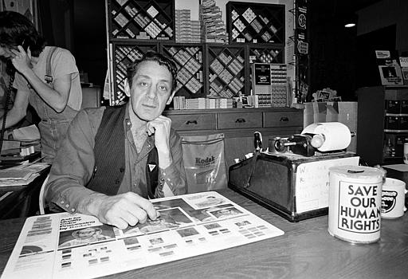
1978: It wasn’t all disco and tight jeans
November 4, 1978: The Briggs Initiative was defeated 58%-42%. (It would have banned openly gay or lesbian people from being employed as teachers in California public schools.)

Slide 11
1978: It wasn’t all disco and tight jeans
November 22, 1978: Openly gay supervisor Harvey Milk was assassinated in San Francisco. His birthday (May 22) is now a Day of Special Significance for public schools in California.
Notes:
Harvey Milk was instrumental in Prop 6 win and most prominent gay person in the country at the time. He was assassinated was a great blow. His birthday (May 22 is one day after mine) and that day is an important one in california schools, an interesting counterpoint to what the Biriggs initiative was trying to do.

Slide 12
Biography
Born
Grenville, Grenada (May 21, 1968)
Lived
Massachusetts, Illinois and California (1970-1978)
Christ Church, Barbados (1978-1986)
Troy, NY (1986-1994)
Los Angeles, CA (1994-2011)
Arlington, VA (2011-2013)
Notes:
Comberemere Years. Went to Barbados at age 10-18 (answer to “where did you grow up question?) Attended a 350-year-old school with ancient traditions with uniforms and ties every day. Other famous alumni include Rihanna—I won’t sign or dance for you however. I became a teenager and was very interested in STEM education. Fave subject was chemistry bt Math was easiest. I did O levels (13) and A levels (4). In 1986 I graduated and moved to the United States, 1986 happens to be another significant year for LGBT history.

Slide 13
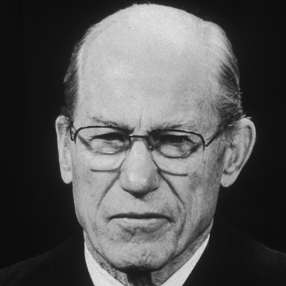
1986: Don’t FRIGHTEN the horses
June 30, 1986: United States Supreme Court upholds Georgia’s anti-sodomy law 5 to 4, ruling that “there is no constitutional right to homosexual sodomy” in Bowers v. Hardwick.
Notes:
Majority opinion by Byron White 5-4.”I don’t care what people do as long as they don’t do it in the street and frighten the horses”. Georgia’s law was about sodomy between any two persons but the Supreme Court twisted it to only be about the particular facts of the case which involved a police office barging into the bedroom of two men having sex
. Sodomy laws were used to equate homosexuality with criminality and this was considered the perfect case for the Sup Ct to affirm homosexuals had some rights (even privacy rights) like americans citizens. Hopes wer dashed.

Slide 14
Biography
Born
Grenville, Grenada (May 21, 1968)
Lived
Massachusetts, Illinois and California (1970-1978)
Christ Church, Barbados (1978-1986)
Troy, NY (1986-1994)
Los Angeles, CA (1994-2011)
Arlington, VA (2011-2013)
Notes:
So its 1986 and I go to RPI (comprmoise between father). The Rennselaer Years. Begin to develop as an academic and actvist.

Slide 15
Biography: What did you do in college?
Attended Rensselaer Polytechnic Institute (B.Sc. 1989, M.Sc. 1992, Ph.D. 1994)
Entered as a Physics major, switched to Applied Mathematics next semester
Participated in summer undergraduate research, had same advisor for grad school 2 years later
Ph.D. thesis in computational aerodynamics (“The Design of Shock-Free Transonic Slender Bodies”)
Notes:
Academic

Slide 16
Biography: What did you do in college?
Came out to self in 1989, everyone else soon after
Elected RPI’s 1st openly gay graduate student senator
Founded LGBT radio program “HomoRadio” in 1992 at WRPI 91.5 FM (Still on the air!)
Created the Queer Resources Directory (QRD.org), the internet’s first compendium of LGBT and HIV/AIDS info, in 1991
Notes:
Activist

Slide 17
Biography
Born
Grenville, Grenada (May 21, 1968)
Lived
Massachusetts, Illinois and California (1970-1978)
Christ Church, Barbados (1978-1986)
Troy, NY (1986-1994)
Los Angeles, CA (1994-2011)
Arlington, VA (2011-2013)
Notes:
Graduated in 1994 moved to Los Angeles to be with my then boyfriend, Dean Elzinga. It’s the longest place I have lived (California) so I consider mysef an Angeleno. Found a partner to develop with and grew more into my identity as STEM professional and an LGB activist.

Slide 18
Biography: WHO’S THE MAN?
DEAN ELZINGA
1990: Met online via IRC/Usenet
1991: Met in person in Los Angeles, CA
1994: Moved in together
1999: Registered as Domestic Partners in CA
2000: Civilly united in Burlington, VT
2008: Legally married in Los Angeles, CA
Notes:
Complications of shaping a life together when policies and laws are ot designed to comport with your identity

Slide 19
THERE (THEN)
Notes:
IT was the early 90s people!

Slide 20
HERE (NOW)
Notes:
Last year…after 20-plus years are we starting to look alike?

Slide 21
Biography: los angeles (1994-2011) Academic
Minority Post-Doctoral Scholar-in-Residence (1994-1996); Tenured (2003); Dept Chair (2005-10)
Occidental College implements same-sex (and opposite-sex) domestic partnership benefits (1995)
Co-created and team-taught cultural studies class Race, Gender and Justice (1997, 1999, 2003) and LGBT Rights in Era of Obama & Google (2009, 2010)
Notes:
Academiic career at Occidental STEM professional but start incorporating LGBT activism in places. At the same time I was emerging as a mathematician and educator

Slide 22
Biography: los angeles (1994-2011) ACTIVIST
Successful co-plaintiff (as QRD.org) in 1997 U.S. Supreme Court case ACLU et al v. Reno
Served on the board of directors of Equality California, Center for Health Justice, Immigration Equality, etc
Co-founded the Barbara Jordan/Bayard Rustin Coalition (Black LGBT political advocacy org) in 2006
Co-organized first LGBT reception at the 1995 Joint Mathematics Meetings in San Francisco
Notes:
Specific highlights of activist stuff during the Los Angeles years. Emphasize transition from Colorado to next big events in LGBT hisyory, which are not are on the pswing or positively sloped part of the curve…

Slide 23
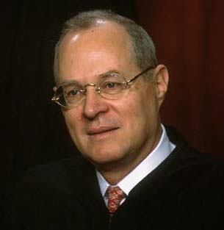
Moving on up… (1994-2011)
May 20, 1996: United States Supreme Court in Romer v. Evans invalidates a 1992 anti-gay ballot measure passed by Colorado voters, saying the “animus towards the class it affects” is not a legitimate state interest.
Notes:
First major win at the USSC for gays.

Slide 24
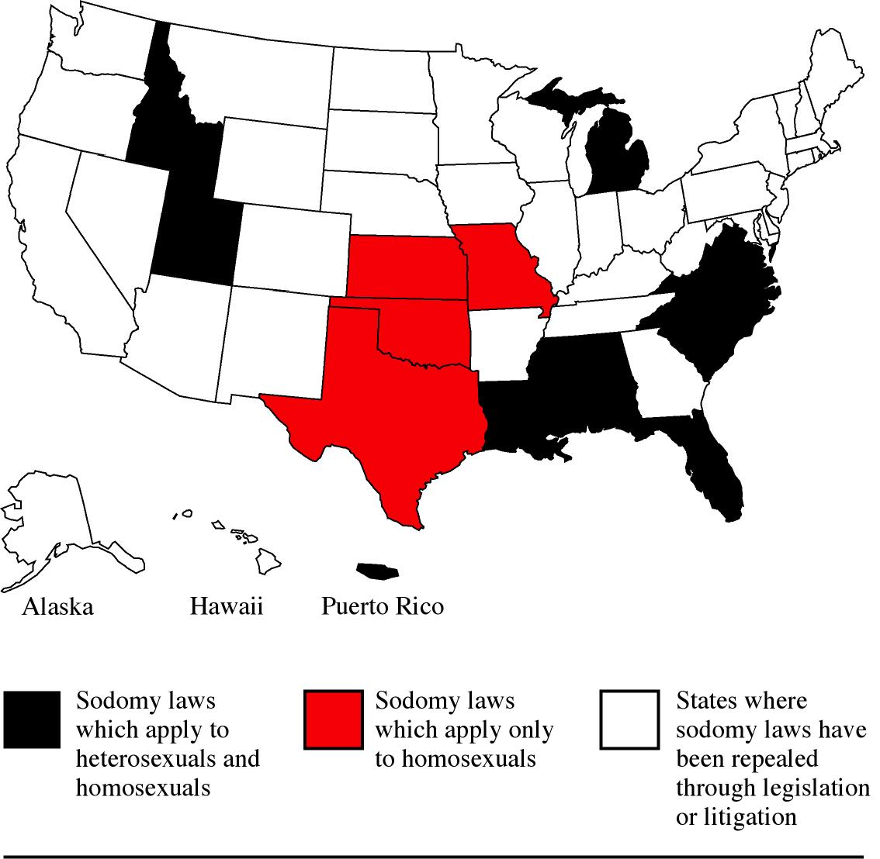
Moving on up…(1994-2011)
June 26, 2003: United States Supreme Court rules 6-3 in Lawrence v. Texas that 1986’s Bowers v. Hardwick “was not correct when it was decided, and it is not correct today.”
Notes:
United States Supreme Court rules in Romer v. Evans that an initiative constitutional amendment passed by Colorado voters prohibiting state and local jurisdictions from banning anti-LGBT discrimination violates the federal constitution because “animus towards the class it affects” is not a legitimate state interest.
United States Supreme Court rules in Lawrence v. Texas that 1986’s Bowers v. Hardwick “was not correct when it was decided and it is not correct now” and thus decides that gay men and lesbians have privacy rights which trump laws that criminalize consensual sex between adults.

Slide 25
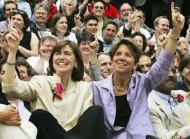
Moving on up…(1994-2011)
May 17, 2004: Legal same-sex marriages begin in the first jurisdiction in the United States (Massachusetts) as a result of state Supreme Court Goodridge v. Department of Public Health decision issued in November 2003.
Notes:
Marriage starts due to a longterm legal stategy dating way back to 1993 in Hawaii which took more than a decade to come to fruition. People have been filing marriage lawsuits since earlyy 1970s

Slide 26
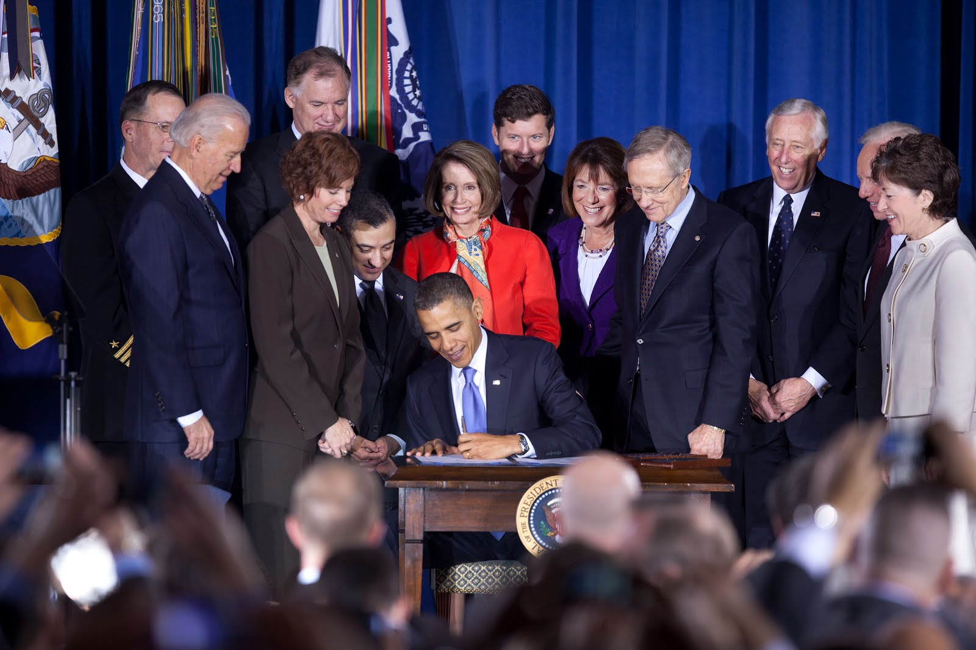
Moving on up…(1994-2011)
December 22, 2010: President Obama signs repeal of the 1993 “Don’t Ask, Don’t Tell” policy into law, ending this bastion of sexual orientation-based workplace discrimination in the federal government on September 20, 2011.
Notes:
Key points of contestation in LGBT movement was around the military, which previously had the statement “Homosexuality is incompatible with military service”. DADT changed that policy but still LGB individuals were discharged from the military despite huge public opinion in favor of getting rid of the policy. Even so it required a dramatic lame duck sente session to pass the policy and a 9 month wait period before it actualy went into effect.

Slide 27
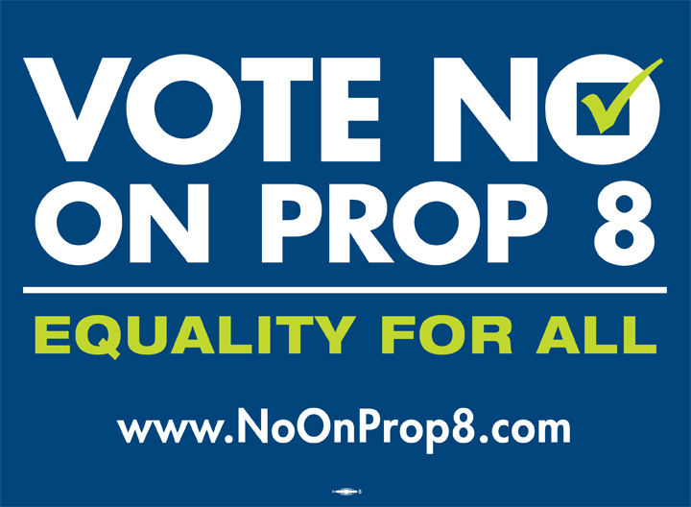
2 STEPS FORWARD, 2 steps back (1994-2011)
November 4, 2008: After an $84M campaign California voters pass Proposition 8, an initiative constitutional amendment prohibiting civil marriage between same-sex couples.
Notes:
The biggest fight over LGBT rights in the modern error was CA’s Proposition 8. $85m (the LGBT side had $44m to $41m for the proponents). Dean and I got married 08/08/08 during the window it was legal. TheMay 15, 2008 case was inspired by the similar decision in Massachusetts.

Slide 28
Biography
Born
Grenville, Grenada (May 21, 1968)
Lived
Massachusetts, Illinois and California (1970-1978)
Christ Church, Barbados (1978-1986)
Troy, NY (1986-1994)
Los Angeles, CA (1994-2011)
Arlington, VA (2011-2013)
Notes:
Last two years in Arlington I have been able to concentrate more on my STEM professional side with occasional forays into LGBT activism

Slide 29
BIOGRAPHY: Arlington, va (2011-2013)
Named 2011 LGBT Educator of the Year by NOGLSTP
Co-founded NSF’s LGBT & Allies employee resource group in March 2012 with Marcelo Vinces of BIO and Janice Hicks of MPS
Co-organized NSF’s first Coming Out Day event on October 11, 2012 featuring Kei Koizumi from White House Office of Science and Technology Policy

Slide 30
ARE WE THERE YET?
YES!

Slide 31
THE WAY WE WERE: 1968
Most states had criminal sanctions against sodomy
No state had any laws prohibiting anti-gay discrimination
No state had any laws recognizing gay relationships
Near universal cultural taboo against homosexuality
Almost no “public homosexuals”
Notes:
In 1968 this ws the state of the law. This is the way we were

Slide 32
NOW (here)
Sodomy laws in U.S. have been unconstitutional for a decade (Lawrence v Texas, 2003)
21 states* (and D.C.) have law banning employment discrimination based on sexual orientation (*Does Not Include Virginia!)
17 states* (and D.C.) have laws banning employment discrimination based on gender identity or gender expression (*Does Not Include Virginia!)

Slide 33
NOW (here)
There is no federal statute banning employment discrimination based on sexual orientation (or gender identity) by private employers
A 2012 ruling by the EEOC indicates that employment discrimination based on gender identity or gender expression is illegal nationwide
Federal government bans LGBT discrimination in federal employment and offers limited DP benefits

Slide 34
NOW (here)
12 states (and D.C.) have enacted marriage equality (6 in the last year: MD, ME, WA, RI, DE, MN)
6 more states (CA, NJ, OR, NV, NJ, IL) have “marriage-lite” laws called civil unions/domestic partnerships
Majority of the public says that they know a co-worker or friend who is gay or lesbian (Gallup, Pew, NY Times)
LGBT celebrities: NBA star Jason Collins, TV host Ellen Degeneres, OPM head John Berry, drag icon RuPaul
Notes:
Ask audience for the names of some: Anderson Cooper, Liz Cheney, Senator Tammy Baldwin,

Slide 35
YESTERDAY (here)
June 26, 2013: U.S. Supreme Court decides in United States v. Windsor that the 1996 federal Defense of Marriage Act is unconstitutional. Legally married same-sex couples must be provided all the same federal rights and responsibilities of marriage that different-sex couples have.

Slide 36
YESTERDAY (here)
June 26, 2013: U.S. Supreme Court rules 5-4 in Hollingsworth v. Perry that proponents of California’s Proposition 8 lacked standing to appeal the measure’s invalidation in 2010 by a federal district court, in effect restoring the right to marry in California for same-sex couples.
Notes:
U.S. Supreme Court says in Hollingsworth v. Perry that proponents of California’s Proposition 8 lacked standing to sue when the Attorney General and California refused to appeal lower court rulings invalidating the measure. Thus Proposition 8 will be removed from the California Constitution and the California Supreme Court’s 2008 ruling allowing marriages by same-sex couples will go back into effect

Slide 37
THE ARC OF MORAL UNIVERSE bends upwards!
Notes:
The Arc of the Moral Universe is Long, But IT bends Towards Justice.

Slide 38
THANK YOU!
Dr. Cora Marrett, Acting Director of NSF
Claudia Postell and Tracey France,
NSF’s Office of Diversity and Inclusion
Janice Hicks, Donna Riley, Harry Stock (and everyone else in the LGBT & Allies Group)
Co-workers from EHR
Everyone Who Attended Today’s Talk

Slide 39
ANY QUESTIONS?
If you are interested in joining NSF’s LGBT & Allies Group please email
LGBT-ADMIN@nsf.gov

Slide 40
Happy lgbt pride month!

