Slide 1
Who Are We?
On the Diversity and Demographics of the Mathematics Community
Electronic Seminar on
Mathematics Education
Ron Buckmire
12p ET, Feb. 18, 2020
math.mit.edu/seminars/esme

Slide 2
Abstract
Mathematics is a human endeavor. In other words, mathematics is done, taught, discovered and learned by people. All people have various identifying characteristics and experiences that affect how they interact with other people and how people interact with them. The identities of the people who are perceived as belonging to the mathematics community are important. Data will be presented about the diversity and demographics of the mathematics community in the United States, followed by a discussion of the significance and implications of the underrepresentation of certain groups.

Slide 3
My goals for today
Pose some questions about how “We” define the “Mathematics Community”
Advocate for the idea that mathematics is a human endeavor
Argue that it matters “Who does the math”
Provide demographic details about the “(United States) Mathematics Community”
Engage in discussion about all these topics and more!

Slide 4
Outline of this presentation
Who are “we”?
  Some definitions of the “Mathematics Community”
Who are we?
  Some demographics of the United States
  Some demographics of the mathematics community
Why should we care?
  Implications of underrepresentation in STEM
  Debate over diversity/equity/inclusion is linked to the talent/grit (FKA “excellence/equity”) divide

Slide 5
What Does A Mathematician
Look Like?

Slide 6
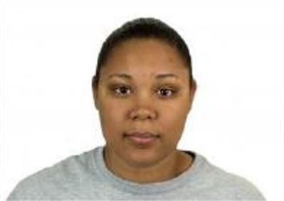
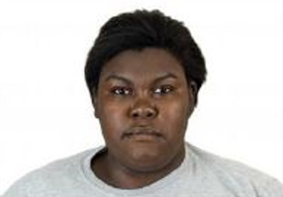
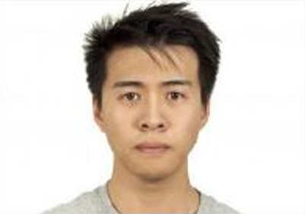
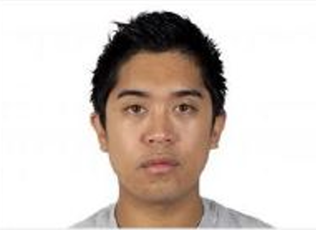
Source: Williams, George-Jones & Hebl (2018)

Slide 7
What Is The “Mathematics Community”?

Slide 8
The Mathematics Community: Some Definitions
The set of individuals who are defined to be mathematicians.
The set of individuals who identify themselves as members of the mathematics community.
The set of individuals who belong to one or more professional mathematics organizations.
The set of individuals who teach, study, research, do, learn, or are interested in, mathematics.
Other?

Slide 9
Def. 3: Membership in Mathematical Organizations

Slide 10
POP QUIZ!
Which mathematics organization has the most members?

Slide 11


Slide 12


Slide 13
Source: Conference Board of the Mathematical Sciences (CBMS)

Slide 14
Source: Conference Board of the Mathematical Sciences (CBMS)

Slide 15
Membership Demographics of SIAM
All Membership (Non-Student) | Number | Percentage
Male | 6446 | 78.70
Female | 1171 | 14.30
Unanswered | 569 | 6.95
Regular Membership (U.S. Only) | Number | Percentage
Male | 6432 | 69.95
Female | 1788 | 19.45
Unanswered | 961 | 10.45
Regular Membership (Non U.S.) | Number | Percentage
Male | 3580 | 74.37
Female | 685 | 14.23
Unanswered | 544 | 11.30
Source: Society for Industrial and Applied Mathematics, 2019.

Slide 16
(Some)
Demographics of the
United States

Slide 17
POP QUIZ!
What is the percentage of the U.S. population that is white?

Slide 18
Race and Ethnicity in the U.S.
Categories (Race and Ethnicity) | Percentage
White | 75.7
Black or African-American | 13.9
American Indian and Alaska Native | 1.7
Asian | 6.3
Native Hawaiian and Other Pacific Islander | 0.4
Hispanic or Latino (any race) | 17.6
Some other race | 5.4
Source: U.S. Census Bureau

Slide 19
Gender in the U.S.
Categories (Total Population) | Percentage
Male | 49.2
Female | 50.8
Categories (Voting Population) | Percentage
Male | 48.4
Female | 51.6
Source: U.S. Census Bureau

Slide 20
(Some)
Demographics of the
Mathematics Community

Slide 21
Mathematics Majors: Gender
Source: Fall 2015 CBMS Survey

Slide 22
Mathematics Degrees: Race & Ethnicity
Source: U.S. Department of Education, National Center for Education Statistics, 2019

Slide 23
Mathematics Degrees: Gender
Source: U.S. Department of Education, National Center for Education Statistics, 2019

Slide 24
Mathematics Ph.D. Recipients: Gender
Source: Annual Survey of the Mathematical Sciences

Slide 25
U.S. Mathematics Ph.D. Recipients:
Race and Ethnicity (Women only)
 | 2007 | 2008 | 2009 | 2010 | 2011 | 2012 | 2013 | 2014 | 2015 | 2016 | 2017
Black | 5 | 11 | 16 | 9 | 9 | 10 | 6 | 9 | 10 | 11 | 11
Hispanic or Latinx | 4 | 5 | 12 | 8 | 9 | 11 | 6 | 7 | 9 | 11 | 6
Asian/P.I. | 29 | 24 | 27 | 39 | 38 | 22 | 34 | 32 | 25 | 25 | 46
Native American | 1 | 0 | 1 | 0 | 0 | 0 | 1 | 1 | 1 | 0 | 1
White | 132 | 161 | 154 | 168 | 155 | 163 | 170 | 179 | 195 | 201 | 189
Other | 22 | 17 | 25 | 21 | 18 | 15 | 22 | 22 | 4 | 3 | 14
TOTAL | 193 | 218 | 235 | 245 | 230 | 224 | 242 | 254 | 244 | 251 | 267
Source: Nicole Joseph, Vanderbilt University and Annual Survey of the Mathematical Sciences

Slide 26
U.S. Mathematics Ph.D. Recipients:
Race and Ethnicity (Men only)
 | 2012 | 2013 | 2014 | 2015 | 2016 | 2017
Black | 16 | 16 | 15 | 10 | 18 | 19
Hispanic or Latinx | 22 | 22 | 24 | 17 | 34 | 27
Asian | 39 | 50 | 38 | 40 | 52 | 68
American Ind. / Alaskan Native | 5 | 0 | 5 | 3 | 2 | 3
Hawaiian /Pac. Isl. | 3 | 1 | 2 | 6 | 5 | 3
White | 492 | 522 | 564 | 545 | 551 | 527
Other/Unknown | 44 | 13 | 16 | 15 | 22 | 39
TOTAL | 628 | 670 | 694 | 636 | 684 | 686
Source: Annual Survey of the Mathematical Sciences

Slide 27
(Some) Implications of Underrepresentation in STEM

Slide 28
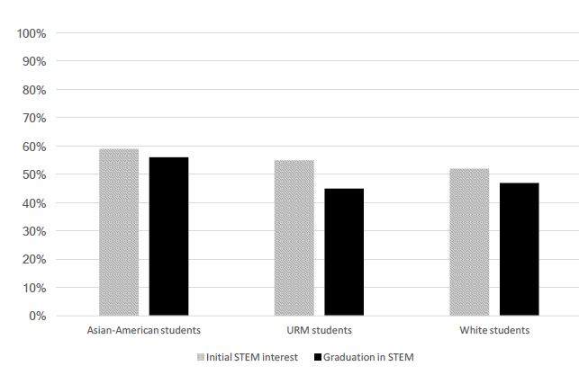
Implications of Underrepresentation in STEM
Percent of students initially interested in STEM,
and graduating in STEM, by racial group.
Source: Williams, George-Jones & Hebl, 2018

Slide 29
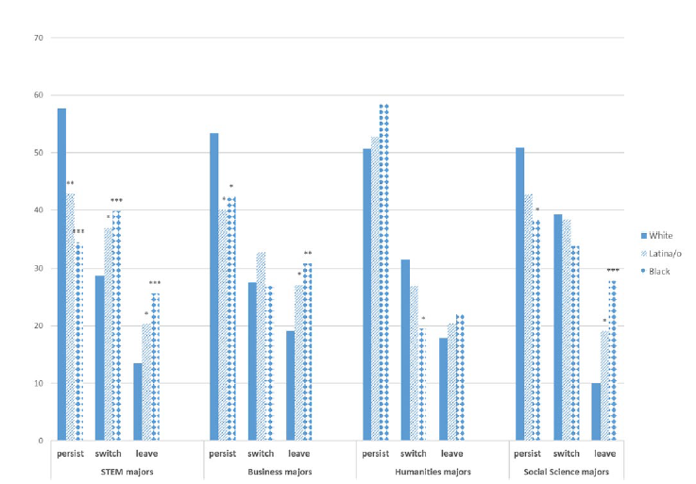
Implications of Underrepresentation in STEM
Different rates of persistence in
academic disciplines by race and ethnicity
Source: Riegle-Crumb, King, & Irizarry, 2019,

Slide 30
Which one is “smart”?
Source: Williams, George-Jones & Hebl, 2018

Slide 31
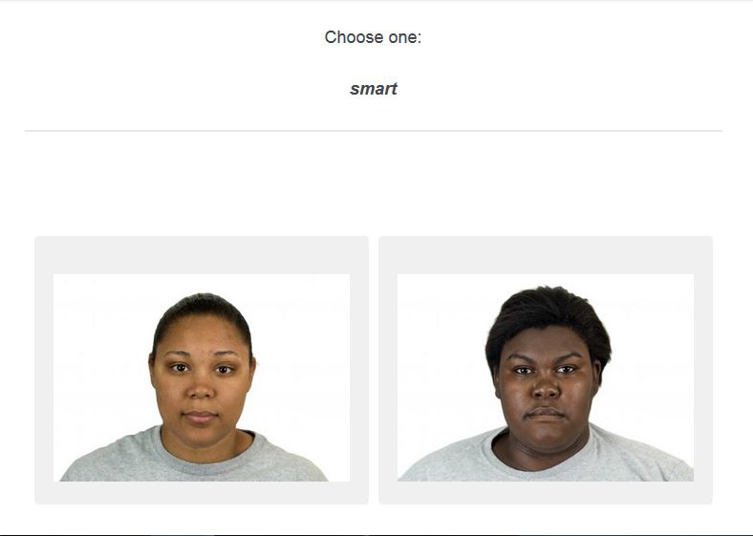
Which one is “smart”?
Source: Williams, George-Jones & Hebl, 2018

Slide 32
Phenotypic Stereotypicality and STEM Persistence (Williams et al, 2018)
Different Racial Groups Have Different Rates of STEM Persistence
Racial phenotypic stereotypicality is a factor in STEM persistence.
Racial phenotypic stereotypicality negatively relates to STEM persistence among college students from under-represented minority groups.
Gender was a more salient factor in African-Americans than among Asian-Americans or White participants

Slide 33
Broadening Participation

Slide 34
(Some) Broadening Participation Efforts
American Mathematics Society
  Committee On Equity, Diversity, and Inclusion
  Director of Diversity and Inclusion(TBA!)
Mathematical Association of America
  Committee on Minority Participation in Mathematics
  National REU Program
  TENSOR-SUMMA grants
  Project NeXT
Society for Industrial and Applied Mathematics
  Diversity Advisory Committee
National Science Foundation
  Broadening Participation portfolio
  Committee on Equal Opportunities in Science and Engineering

Slide 35
References

Slide 36
References
American FactFinder. 2013-2017 American Community Survey 5-Year Estimates. U.S. Census Bureau. Available online at https://factfinder.census.gov/faces/tableservices/jsf/pages/productview.xhtml?src=CF
David Bressoud. Private Communication. 2018.
Annual Survey of Mathematical Sciences. Available online at http://www.ams.org/profession/data/annual-survey/
Nicole Joseph. “I DO (NOT) Belong: Experiences of Black Women and Girls in Mathematics Education.” Plenary Presentation. Critical Issues in Mathematics Education, Berkeley, CA (March 15, 2017).
National Center for Education Statistics. Digest of Education Statistics. 2019.

Slide 37
References (continued)
Richelle (Rikki) Blair; Ellen E. Kirkman; James W. Maxwell. Statistical Abstract of Undergraduate Programs in the Mathematical Sciences in the United States: Fall 2015 CBMS Survey. 2018.
Society for Industrial and Applied Mathematics. Private Communication. 2019.
Melissa J. Williams; Julia George-Jones; Mikki Hebl. “The Face of STEM: Racial Phenotypic Stereotypicality Predicts STEM Persistence by –and Ability Attributions about – Students of Color.” Journal of Personality and Social Psychology. October 15 2018. https://doi.org/10.1037/pspi0000153.
David Bressoud. Persistence of Black and Latino/a Students in STEM. June 1, 2019. https://mathvalues.squarespace.com/masterblog/launchings201906

Slide 38
Discussion

Slide 39
Thank You
Ron Buckmire
Professor of Mathematics
Associate Dean for Curricular Affairs
Core Program Director
ron@oxy.edu | 323-259-2536
OXY Occidental College
oxy.edu | 1600 Campus Road | Los Angeles, CA

