Slide 1
Modeling a Harmonic Oscillator
Alex Zheng Ludwin Romero

Slide 2
Agenda
•What is the harmonic oscillator
•Modeling the simple harmonic oscillator
•The harmonic oscillator with damping
•The harmonic oscillator with a rubber band
•Application of the harmonic oscillator to an active shock absorber

Slide 3
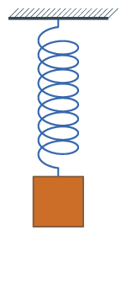
What is the harmonic oscillator?
In mechanics, a harmonic oscillator is a system that, when displaced from its equilibrium position, experiences a restoring force, F, proportional to the displacement, x,
F=-kx

Slide 4



Simple Harmonic Oscillator
The classic harmonic oscillator is given by the second order homogeneous linear equation
where m is mass b is the damping coefficient, and k is the spring constant
The second order ode is written in terms of first order ode’s, which can be written as

Slide 5
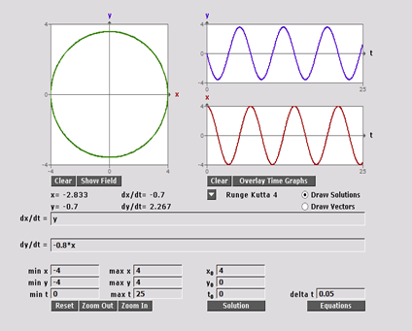
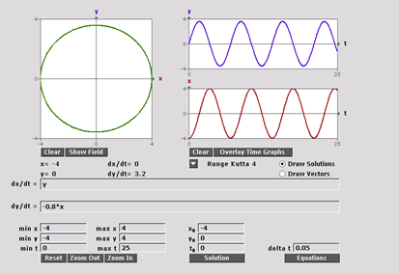
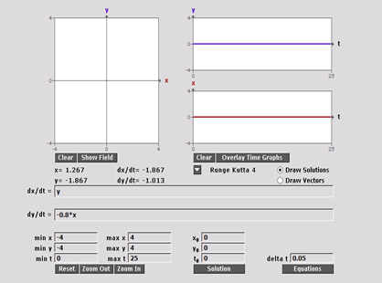
Phase Portrait b = 0
Using HPG System Solver, choosing m = 5, k = 4 and b = 0

Slide 6
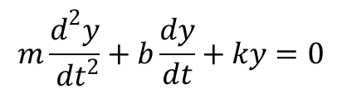

Simple Harmonic Oscillator with damping
Similar to the harmonic oscillator without damping the equation for this model is
The second order ode is written in terms of first order ode’s, which can be written as

Slide 7
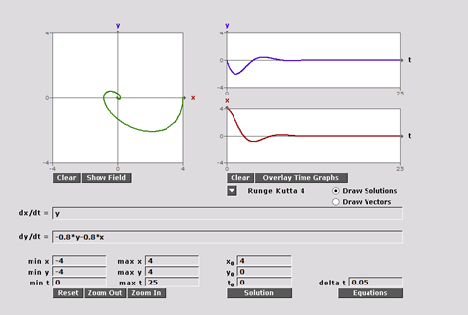
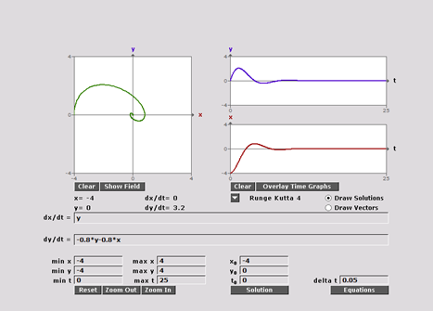
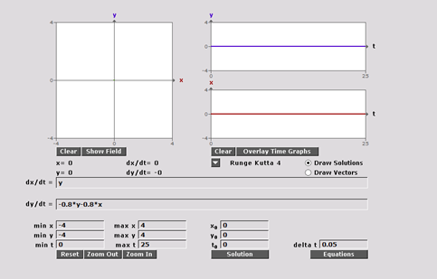
Phase Portrait with damping
Using HPG System Solver, choosing m = 5, k = 4 and b = 4

Slide 8
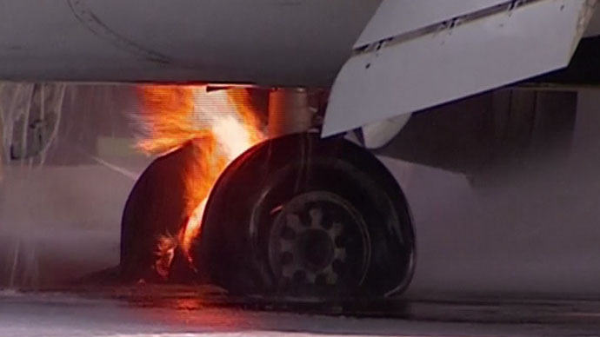


Simple Harmonic Oscillator with nonlinear damping
This model is given by
Note the damping force is directed is directed opposite the direction of motion
Four inches of slush was enough to cause a 1958 plane crash. Large airplanes are one allowed to take off in no more than ½ inch of wet snow/ slush

Slide 9
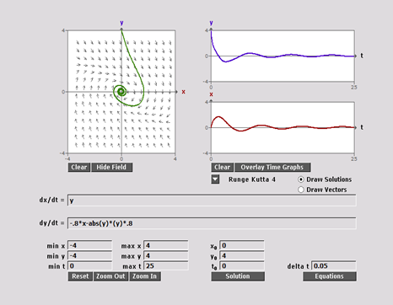
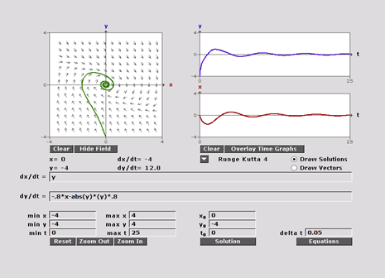
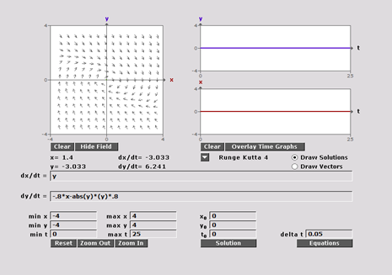
Phase Portrait with nonlinear damping
Using HPG System Solver, choosing m = 5, k = 4 and b = 4

Slide 10
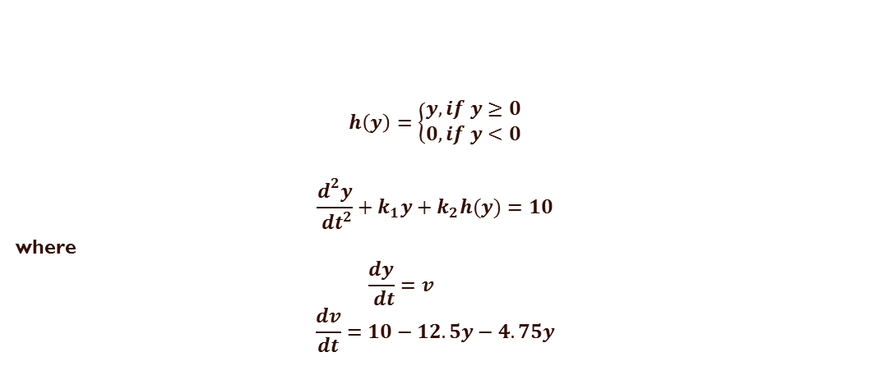
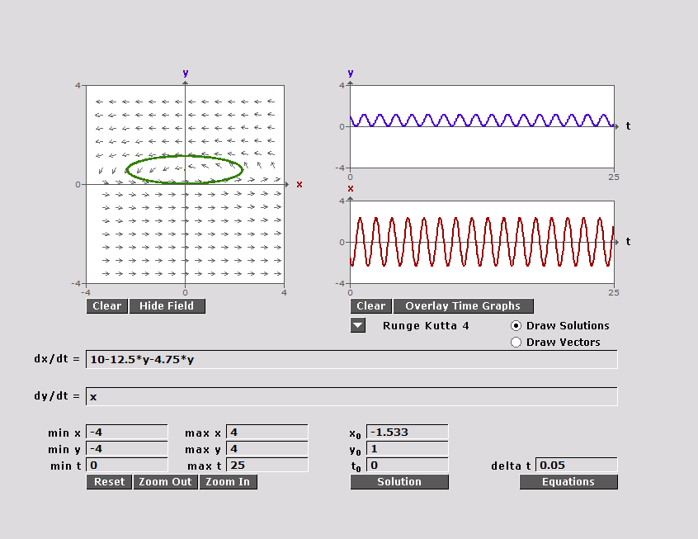
Harmonic Oscillator with rubber band and no damping

Slide 11
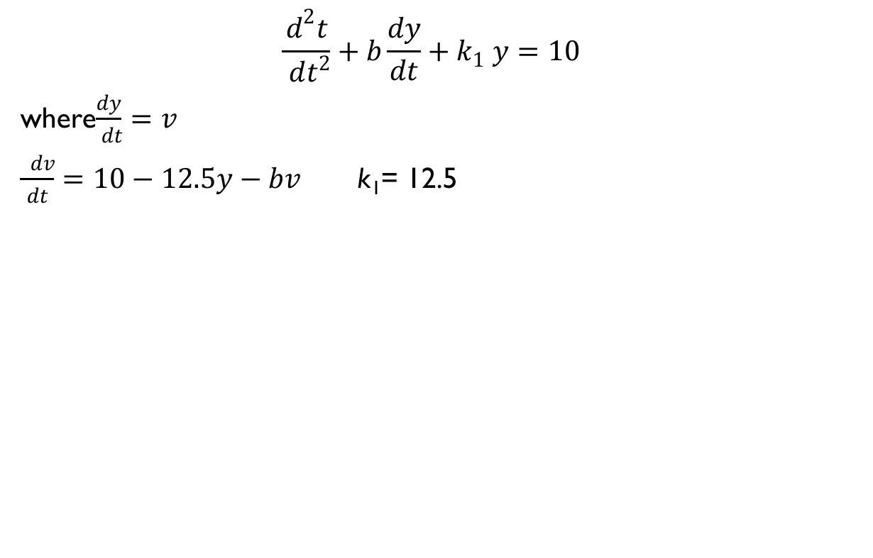
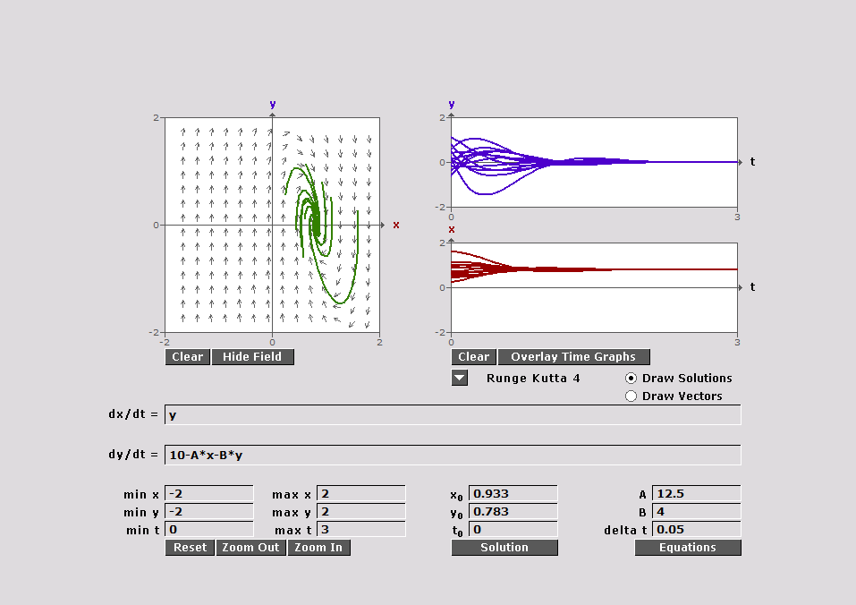
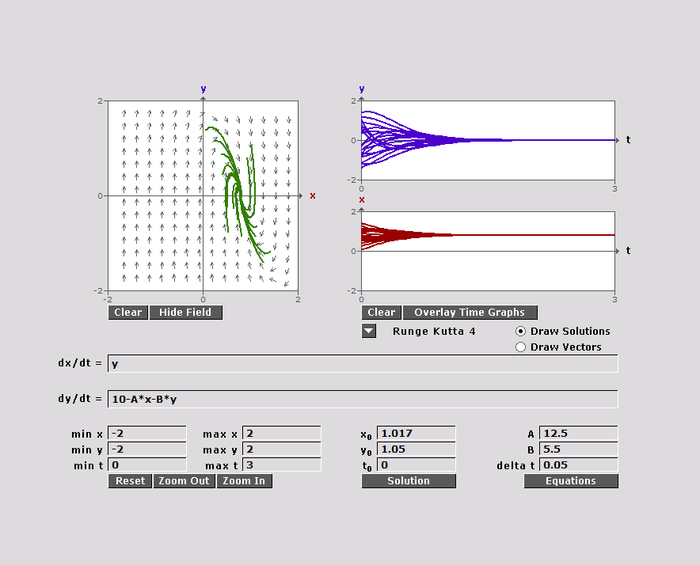
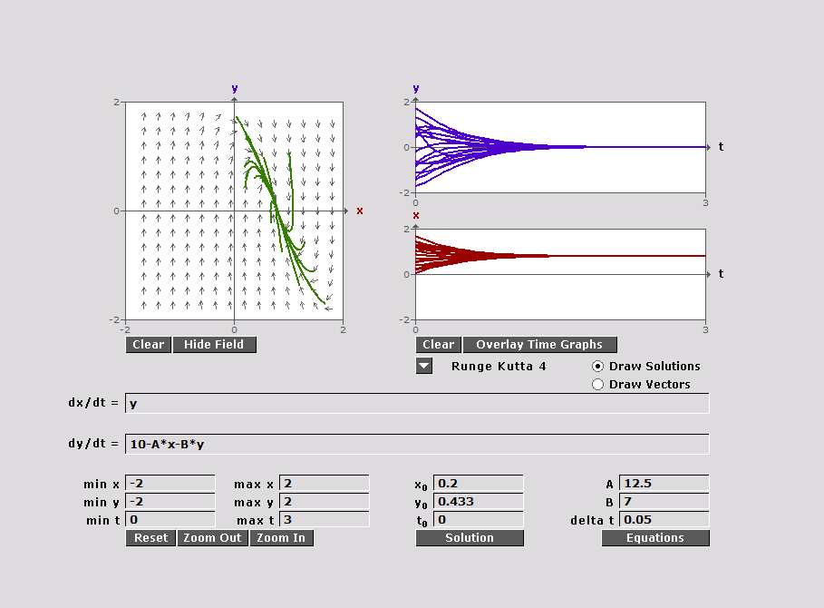
Harmonic Oscillator with Damping and No Rubber Band
b=4, spiral sink b=5.5, sink b=7, sink

Slide 12
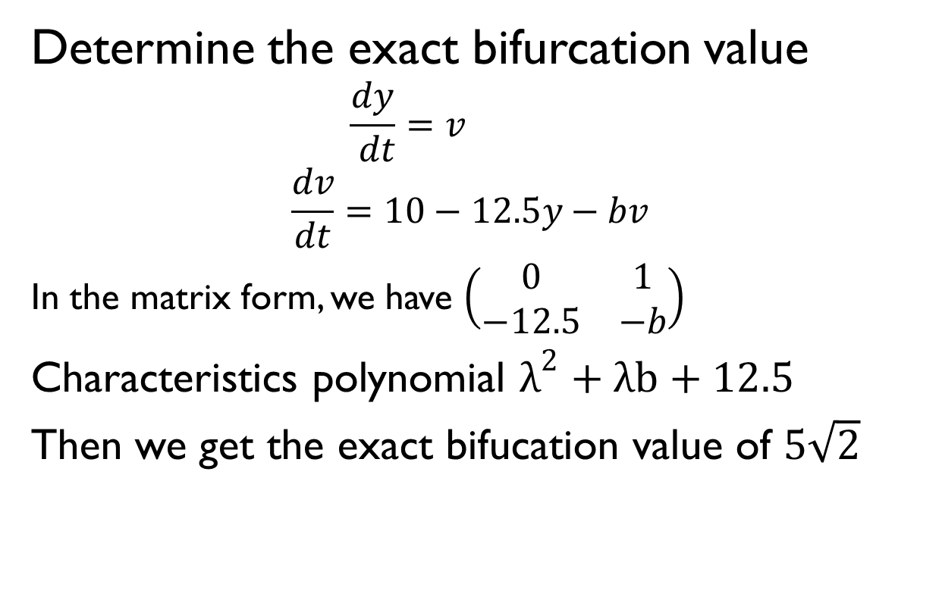
Continue….

Slide 13
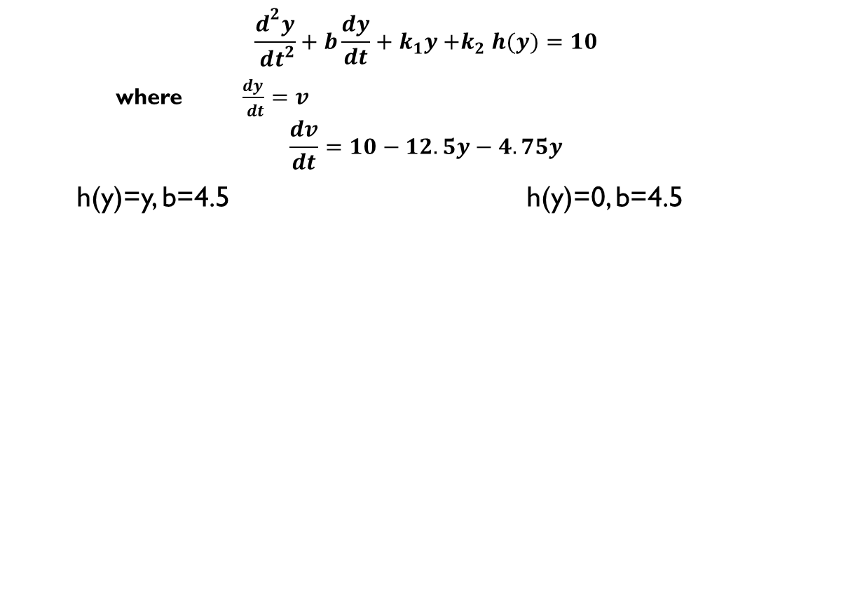
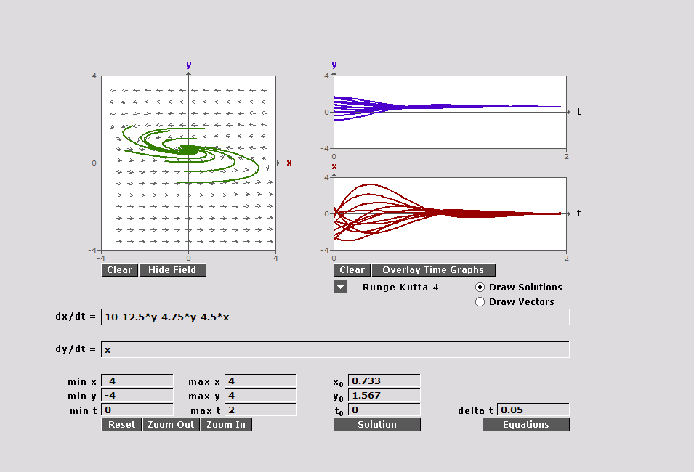
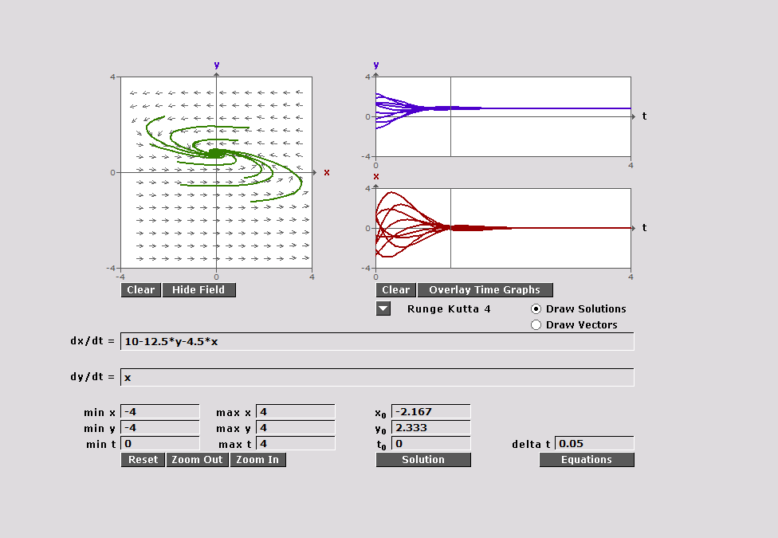
Harmonic Oscillator with rubber band and damping

Slide 14
Active Shock Absorber
Placing an MR fluid in a shock absorber changes the applied magnetic field and alters the damping of the fluid.
Perfect ride would have k=0 and b=0 where the seat would be floating
B is too large the seat tops out, b is too small bottoms out

Slide 15

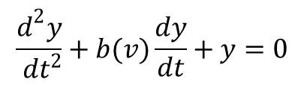



Active Shock Absorber
Considering a modification to the harmonic oscillator of the form
Investigating solutions

Slide 16
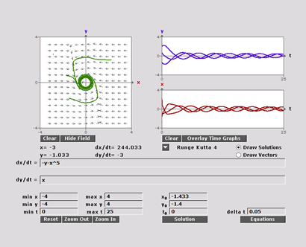
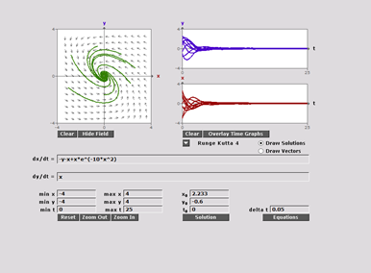
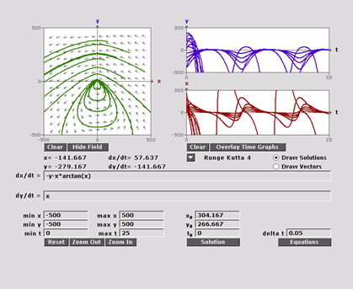
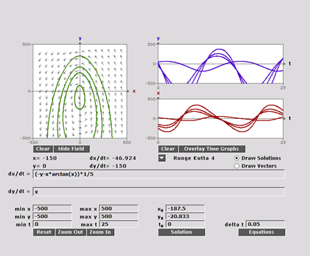
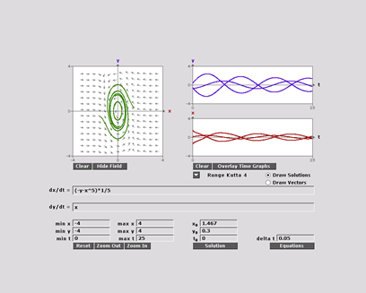
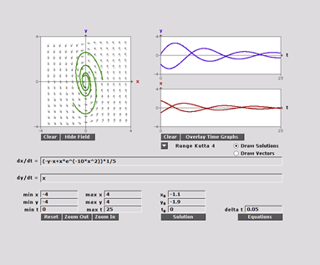
Phase Portrait Shock Absorber

Slide 17
Conclusion
Brief explanation harmonic oscillator
Modeling the simple harmonic oscillator, with/without linear and nonlinear damping
Explored an application to a seat shock absorber

Slide 18

Questions

