Slide 1
Modeling Reaction Kinetics
Christian Kendall and Galen Mack-Crane

Slide 2
Reactions
Mass-Action Kinetics
Michaelis and Menten (1913)

Slide 3
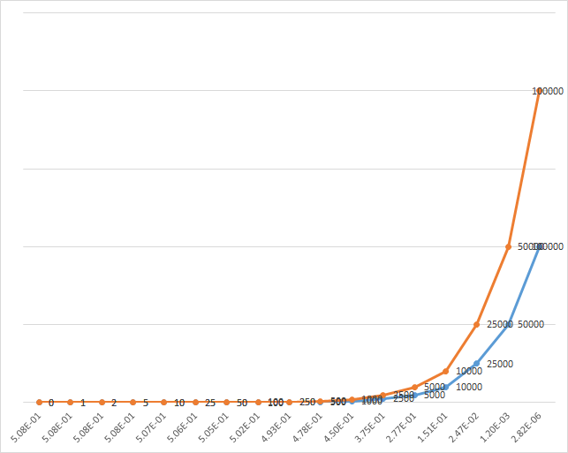
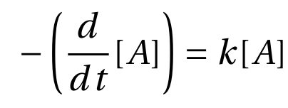
First Order
[C] conc. by %mass
Time (years)

Slide 4
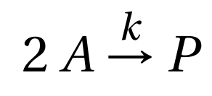
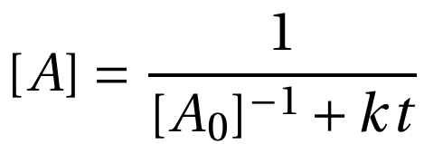
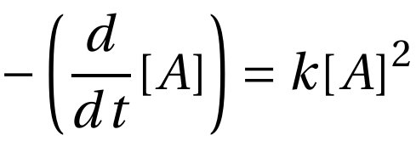
Second Order Unimolecular

Slide 5
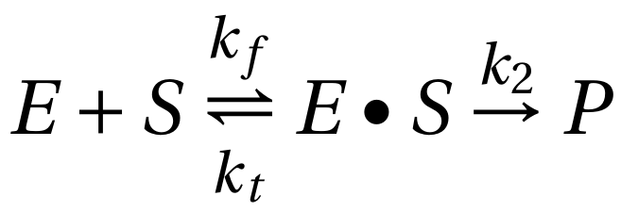
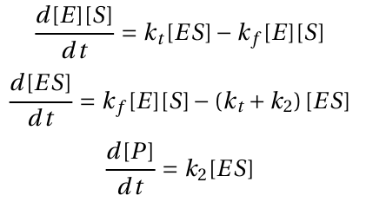
Enzyme-Substrate Reactions
Bimolecular with termination step
2D System:

Slide 6
Enzyme-Substrate Reactions
Sink behavior
Tr < 0
For complex eigenvalues:
Eigenvalues are always real!

Slide 7
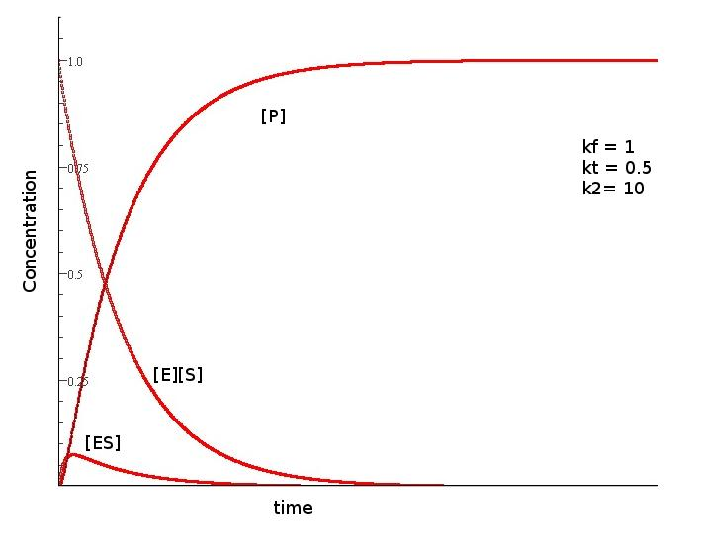
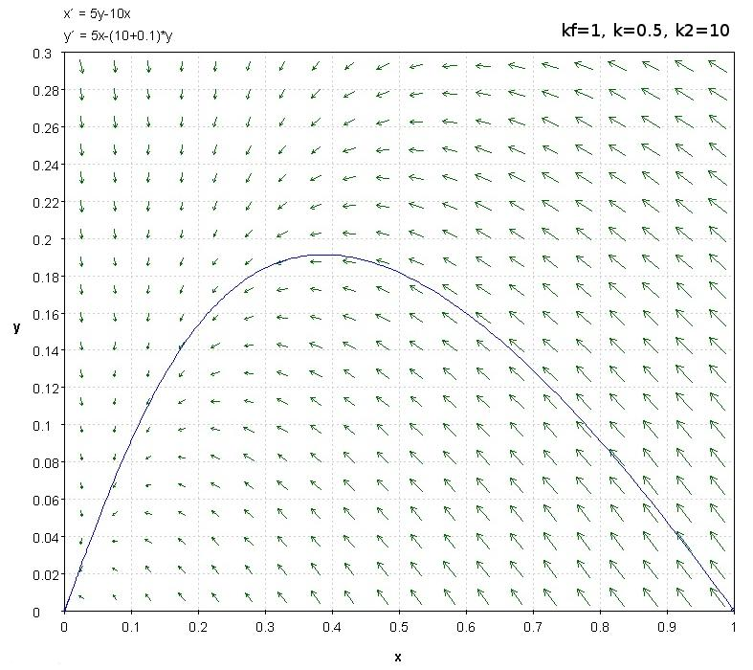
Enzyme-Substrate Reactions
[ES]
[E][S]
Graph generated using John Polking’s DField applet (Rice University)
Graph generated using Marek Rychlik’s JOde applet (University of Arizona)

Slide 8
Michaelis-Menten Result
Steady-State Approximation
[E][S] and [ES] in equilibrium
...algebra...

Slide 9
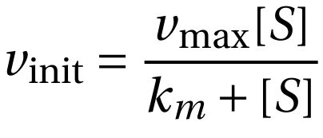
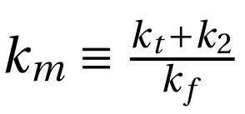
Michaelis-Menten Result
Where

Slide 10
Application
Reaction analysis
Determination of Activity
Crystallization
Purification

Slide 11
Further Study
>2D Systems
Numerical analysis

Slide 12
Thank you for your attention!

