Slide 1
Modeling Harmonic Oscillations and its Applications
By Dallas Gosselin and Jonathan Fernandez

Slide 2
“Introduction”
Real World Harmonic Oscillators
Harmonic Oscillator equation:
Thesis:
The damping coefficient in the harmonic oscillator equation is the most important parameter an engineer must account for, as this coefficient has the largest impact on determining the dynamics of the system being modeled.

Slide 3
Simple Undamped harmonic motion
Damping coefficient equals zero, so the system is given by
Phase portrait is a cycle about the origin with counterclockwise rotation
Solutions are sinusoidal with constant amplitude
Amplitude depends only on initial conditions, not the parameters
Period of the system is dependent upon the parameters, and is given by

Slide 4
Damped harmonic motion
Nonzero damping coefficient, so the system is given by
Phase portrait is a spiral sink about the origin, rotating counterclockwise
Solutions are sinusoidal with exponentially decaying amplitude. The oscillator returns to its “at rest position” (stable equilibrium) over time
Amplitude depends only on initial conditions, not the parameters
Period of the system is dependent upon the parameters, and is given by

Slide 5
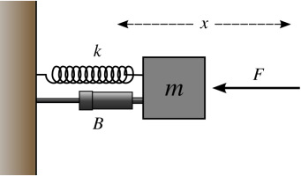
Analyzing mass spring systems and bifurcations with and w/o an additional non-compressive force (Rubber Band)
Undamped harmonic oscillator
Damped harmonic oscillator
Undamped harmonic oscillator w/ rubber band
Damped harmonic oscillator w/ rubber band
http://capone.mtsu.edu/wroberts/shm.htm

Slide 6
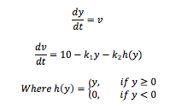
Undamped Harmonic Oscillator With and Without the Rubber Band
Without the Rubber Band (Case 1)
With the Rubber Band (Case 3)
The system is:
Parameter values for the spring constant 12<k₁<13
Phase plot analysis
The system is:
Parameter values for the spring constant k₁=12.5 and 4.5<k₂<5
Phase plot analysis

Slide 7
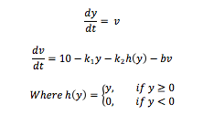
Damped harmonic oscillator With and Without the Rubber Band
Without the Rubber Band (Case 2)
With the Rubber Band (Case 4)
The system is:
Parameter values for the spring constant k₁=12.5, damping coefficient 1< b<10
Phase plot analysis
The system is:
Parameter values for the spring constant 12<k₁<13
Phase plot analysis

Slide 8
Bifurcations
B=5
B=6
B=7
Without the Rubber Band (Case 2)
With the Rubber Band (Case 4)

Slide 9
Active Shock Absorbers
Shock absorbers with Magnetorheological (MR) fluid create an adjustable damping coefficient
Goal of these systems is achieve perfect balance of safety and comfort
Damping factor is a function of velocity. We examined three different functions for b(v)
Motion Master Ride Management System
http://www.lord.com/products-and-solutions/magneto-rheological-(mr)/seat-suspension.xml

Slide 10
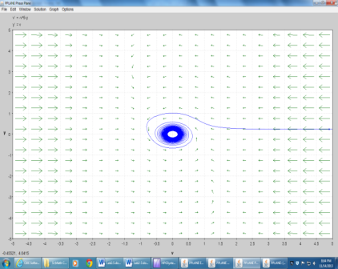
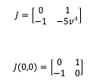
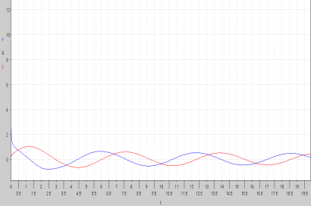
With b(v)=v⁴, we get the system
Taking the Jacobian:
Which at the origin yields
with eigenvalues λ=±i, so this system can be classified as an unstable center by linearization
y(t) graph revealed that solutions were actually approaching the origin, but only after large increments of time
Realistically, this system will experience minor oscillations from both small and large road bumps

Slide 11
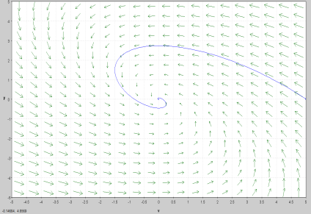
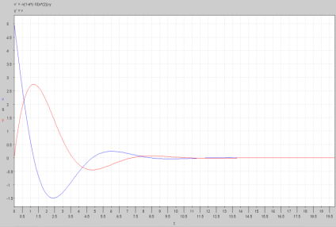
With b(v)=1-e^{-10v^2} , we get the system
Spiral sink solutions, damping effect is very efficient
For small initial velocities, initial amplitudes are small, so the seat will have its intended effect
However, at large initial velocities, there is a sharp jump in the y-position, which means the seat will “bottom out”-a potential safety hazard

Slide 12
With b(v)=arctan(v), we get the system
System follows a periodic cycle, and the amplitudes of the y(t) and v(t) graphs are enormous
As we increased time to larger and larger values, no damping actually occurred
The seat would clearly bottom out for any size pothole or bump in the road, and it will never return to stable equilibrium
Therefore, this system should never be used to model an active shock absorber

Slide 13
Active Suspension
http://www.youtube.com/watch?v=q8sVDenpPOE

Slide 14
Conclusion
Parameters and the dynamics of the oscillator
Direct proportionality of the restoring force and displacement, and the damping coefficient and velocity of an object.
Damping Coefficient and sinusoidal motion
Engineering Applications today!

Slide 15
Work Citied
Blanchard, Paul, Robert L. Devaney, and Glen R. Hall. Differential Equations. 4th ed.Pacific Grove, CA: Brooks/Cole Pub., 2012. Print.
Giancoli, Douglas C. Physics for Scientists & Engineers with Modern Physics. 4th ed.Upper Saddle River, NJ: Prentice Hall, 2009. Print.

Slide 16
Enjoy Finals!

